Slide 1
EURAF European Agroforestry Federation
General Assembly 4 June 2014
Cottbus, Germany

Slide 2
Activity Report OCTOBER 2012 – May 2014
Christian Dupraz, President

Slide 3
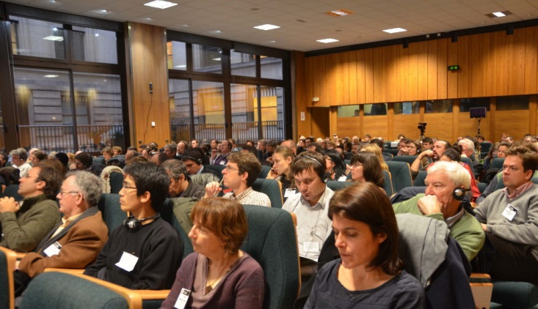
European Agroforestry Federation
Born 16 December 2011 in Paris
First General Assembly 2012 in Brussels
Monthly meetings of the Executive Committee

Slide 4
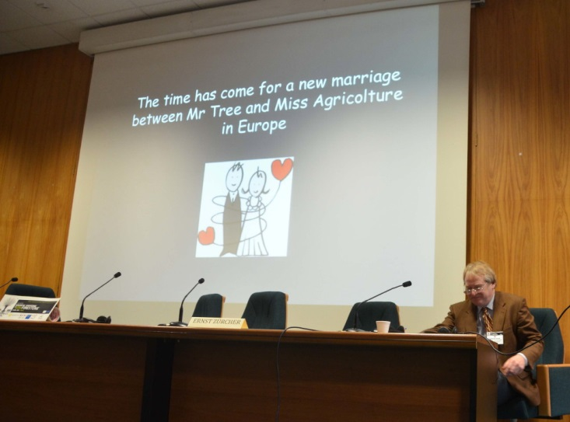
European Agroforestry Federation

Slide 5
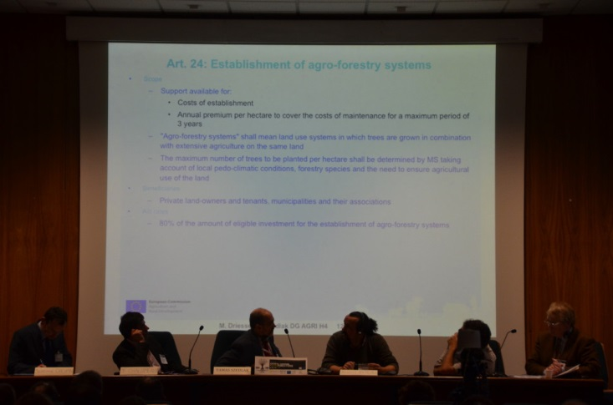

Slide 6
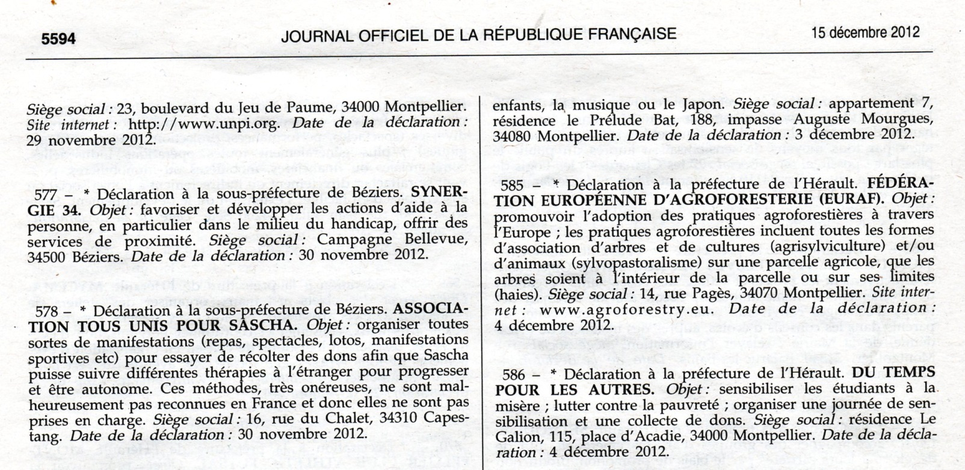
Major events since 2012

Slide 7
Major events since 2012
Constitution finalized and EURAF declared as a French NGO (15/12/2012)
Official headquarters in Montpellier
Bank account opened (Crédit Agricole du Languedoc)
Web-site opened thanks to Gerry Lawson and Joao Palma : www.agroforestry.eu
Logo designed by Christopher Morhardt and Adolfo Rosati
EURAF successful in two European projects : AGFORWARD, AGROFE
Two staff contracted : Anja Chalmin and Jabier Ruiz Mirazo

Slide 8
Consolidating EURAF
Asociacion Europea de Sistemas Agroforestales
Evropaiki Enosi Agrosadoponias
Europäische Gesellschaft für Agroforstwirtschaft
European Agroforestry Association
Fédération Européenne d’Agroforesterie
Associação Europeia de Agroflorestas

Slide 9
Consolidating EURAF
2013 : 99 members
30 May 2014 : 252 members

Slide 10
Countries with national associations members of EURAF
Only 3 in 2011 (UK, France, Greece)
5 more in 2014 (Spain, Italy, Germany, Belgium, Sweden)
2 countries in the process (Czech, Portugal)

Slide 11
Countries with individual members of EURAF

Slide 12
Countries with no members of EURAF

Slide 13
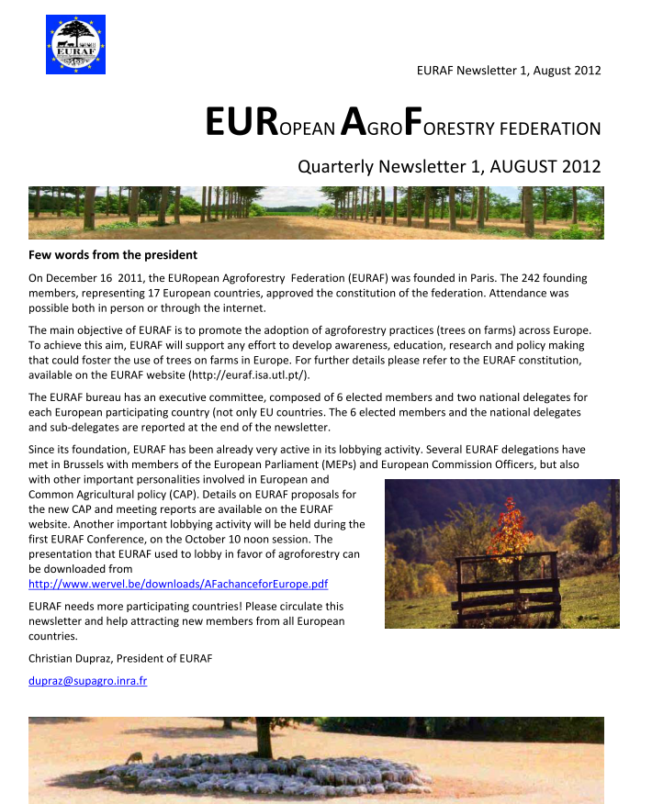
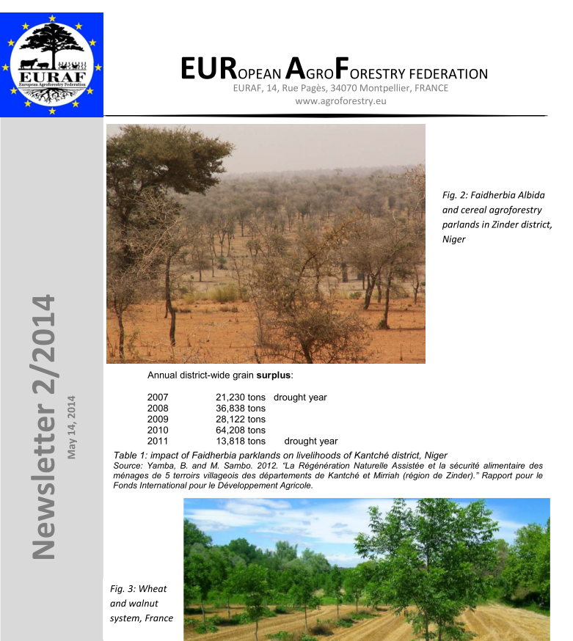
EURAF Newsletter
4 issues
July 2012 (Christian Dupraz)
March 2014 (Christian Dupraz)
May 2014 (Patrick Worms)
June 2014 (Rosa Mosquera)

Slide 14
Lobbying for agroforestry
In Brussels : Common Agriculture Policy
Parliament
European Commission
Forestry and cork advisory group
Civil Dialogue Groups (7 groups)
Direct payment and greening
Environment and climate change
CAP
Rural Development
Forestry and cork
Animal
Arable
In international events (World Agroforestry Congress)
At national and regional levels

Slide 15
Lobbying in Brussels
Positions papers
Meetings with DGs
Meetings with MEPs
Contract with ALIENOR for 2014 (Mélanie Lamaison)

Slide 16
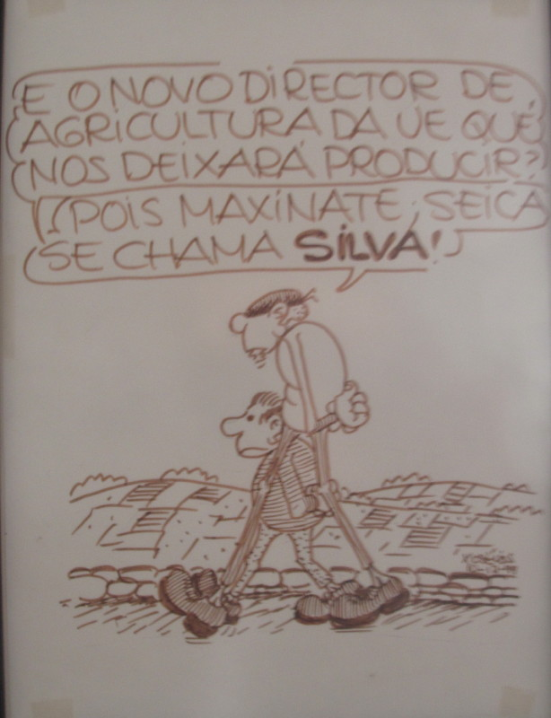
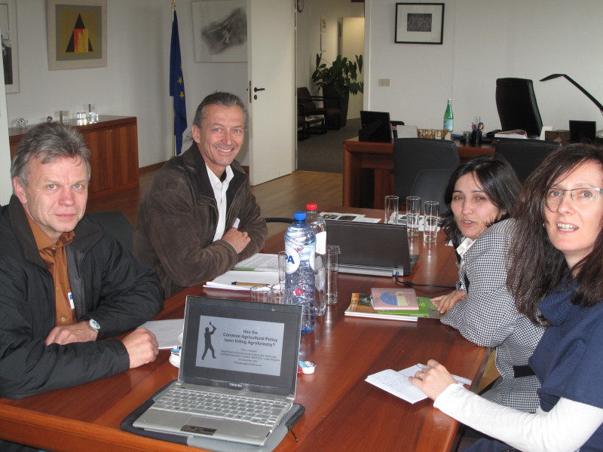

Slide 17
Lobbying achievements
AF in the first pillar of CAP
AF in the second pillar of the CAP
AF Project pilot?
EURAF in most important committees
National level : all has to be done

Slide 18
TAKING PART IN EUROPEAN PROJECTS on agroforestry

Slide 19
EURAF in AGFORWARD
Major European project on Agroforestry : we had to be there.
Right choice…
Project proposal written by CD
EURAF budget : 150483 €
Two staff contracted
EURAF contact : Norbert Lamersdorf
No | Participant short name | Prefinancing (January 2014) | Interim Payment 1 (March 2015) | Interim Payment 2 (August 2016) | Final Payment (January 2018) | Total payments
26 | EURAF | 72733.00 | 17556.80 | 30096.60 | 30096.60 | 150483.00

Slide 20
EURAF in AGROFE
European project on training in Agroforestry
EURAF budget : 9000 €
EURAF contact : Sylvie Guillerme

Slide 21
EUROPEAN CONFERENCES ON AGROFORESTRY
A major EURAF commitment
Every two year : 2012, 2014, 2016 …..
After Brussels, Cottbus and possibly Montpellier in 2016

Slide 22
First CONFERENCE
Brussels 2012
Around 100 participants
FIRST EUROPEAN AGROFORESTRY CONFERENCE
"Priorities for European Agroforestry" October 9-10, 2012

Slide 23
SECOND CONFERENCE
Cottbus 2014
Around 150 participants

Slide 24
EURAF MANAGEMENT

Slide 25
The EURAF Executive Committee
6 elected officers
President : Christian Dupraz
Deputy-President : Stephen Briggs
Secretary : Rosa Mosquera
Deputy-Secretary : Jeroen Watté
Treasurer : Dirk Freese
Deputy-Treasurer : Giustino Mezzalira

Slide 26
The EURAF Executive Committee
National Delegates from 13 countries
Belgium : Bernard Maus
Czech republic : Bohdan Lojda (joined 2014)
France: Sylvie Guillerme, Yves Gabory
Germany: Norbert Lamersdorf, Heinrich Spiecker
Greece: Konstantinos Mantzanas, Anastasia Pantera
Italy : Adolfo Rosati
Kosovo : Sami Kriezyu
Portugal: João HN Palma, Joana Amaral Paulo
Spain : Gerardo Moreno
Sweden : Johanna Björklund, Jan Eksvärd
Switzerland: Felix Herzog, Mareike Jäger
The Netherlands: Mark Vonk, Emiel Anssems
UK : Jo Smith, Mike Strachan

Slide 27
The EURAF Executive Committee
Total : 19 members
Quorum at 10 present
38 meetings of the EC (first Tuesday of the month at 10:30 am CET by Skype)
All meeting reports available on the Web site
Attendance was not satisfactory. 5 countries were never represented during the last year

Slide 28
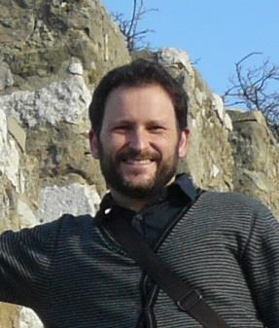
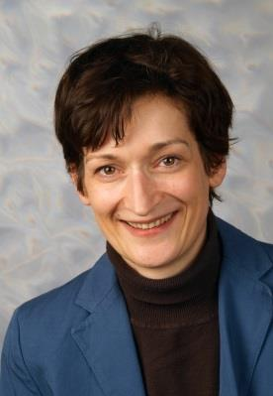
EURAF’s STAFF
Anja Chalmin, animation officer
Contract : April 2014 to March 2016
Jabier Ruiz Mirazo, policy officer
Contract : June 2014 to September 2015

Slide 29
And now?
Euraf is now on good tracks
Time to be more professional
New projects necessary
Let’s share the burden

Slide 30
A new step : IUAF

Slide 31
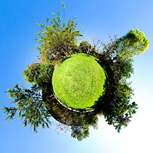
Merci pour votre attention!

Slide 33
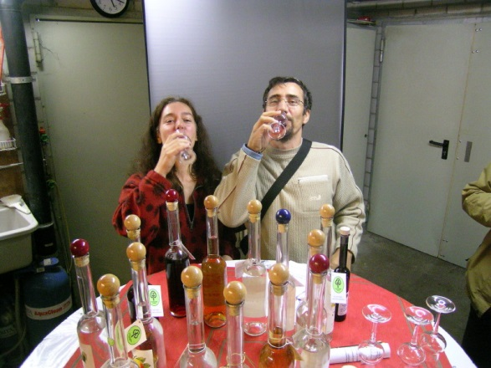
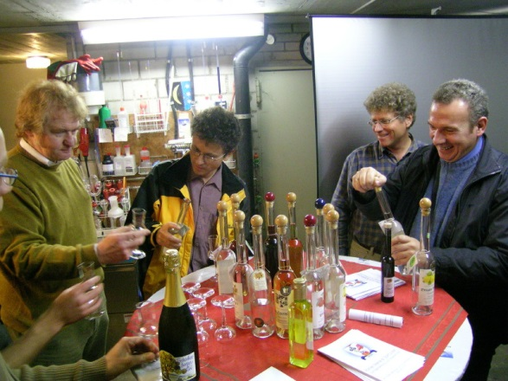
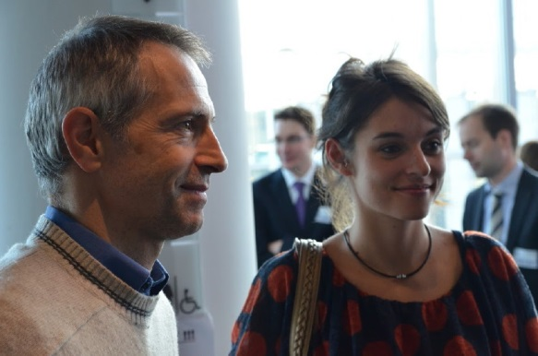
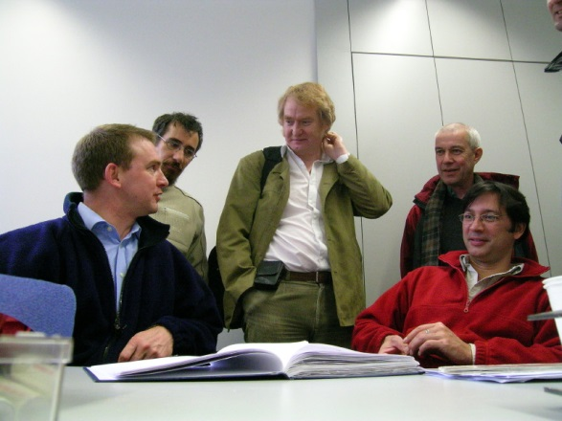
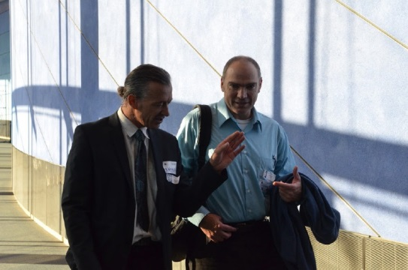
Merci!

